Slide 1
Software Engineering CS20006
Lecture 2
Requirement Specification

Slide 2
Lecture #2
System Requirement Specification (SRS)
SRS Document Template

Slide 3
System Requirement Specification
Objectives:
Understanding the precise requirement of the customers
Avoids bitter developer-customer disputes
Legal battle, timely payment
Requirements documentation
Several contractors can bid for the contract, offering, perhaps, different ways of meeting the customer’s need
To avoid number of iterative changes during the development life cycle

Slide 4
Requirement Engineering
Requirements for a system are the description of the services provided by the system and its operational constraints
The process of finding out, analyzing, documenting and checking these services and constraints is called Requirements Engineering

Slide 5
Requirement Engineering
Activities:
Requirement gathering and analysis
Requirement specification
Note: SRS activities are carried out by System
Analysts

Slide 6
Requirement Gathering and Analysis
Requirements gathering
What is the problem?
Why it is important to solve the problem?
What are the possible solutions to the problem?
What exactly are the input to the system and what exactly are the output required from the system?
What are the likely complexities that might arise while solving the problem?
If there are external software or hardware with which the developed software has to interface, then what exactly would the data interchange formats with the external system be?

Slide 7
Requirement Gathering and Analysis
Requirements analysis
Resolve anomaly/ambiguity in the requirement (customer)
e.g. Distributed system without the specification of network protocols
Resolve the contradiction in requirement
e.g. OODBMS and SQL query, faster execution with lesser memory requirement
Resolve incompleteness
Overlooked in some requirements

Slide 8
Requirements Specification
User requirements
High level abstract requirement
Are statements, in a natural language plus diagrams, of what services the system is expected to provide and the constraints under which it must operate
System requirements
Detailed description of what the system should do
Set out the system’s functions, services and operational constraints
Functional requirements
Non-functional requirements
Interface requirements

Slide 9
Functional Requirements
Functional system requirements describe the system function in detail, its inputs and outputs, exceptions, and so on
It should be
Complete
All services required by the user should be defined
Consistent
Requirements should not have contradictory definitions

Slide 10
An Example: ATM
Case Study: Automated Teller Machine

Slide 11
ATM: Functional Requirements
Withdraw Cash
Deposit Cash
Balance Enquiry
Passbook Update
Transaction Details
PIN Change

Slide 12
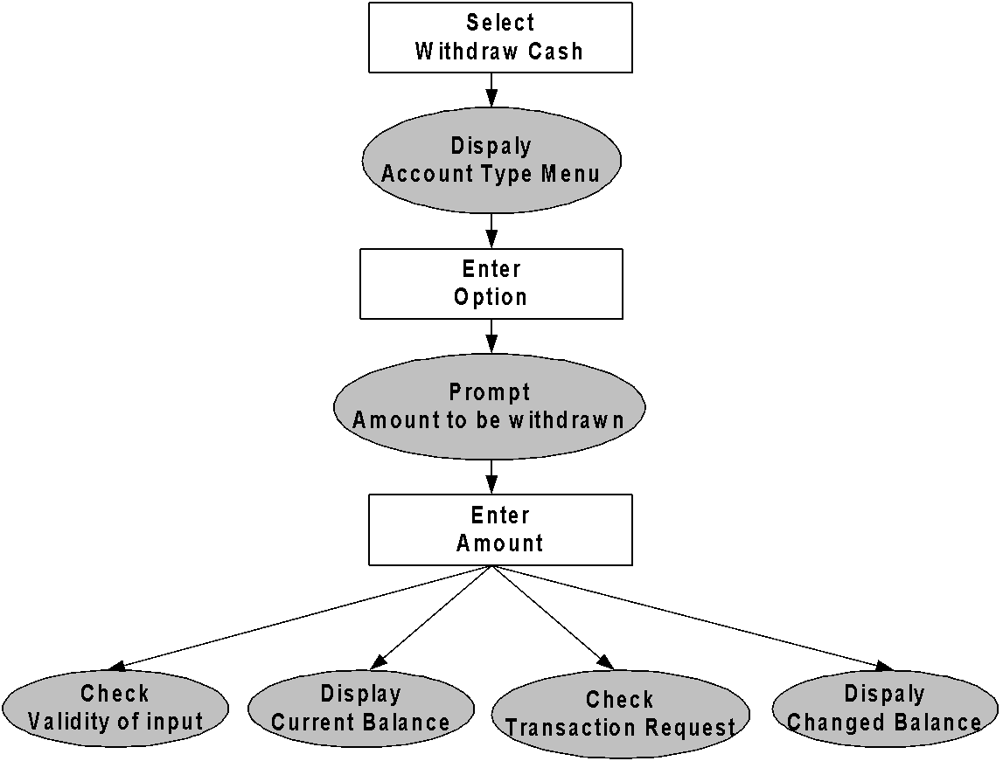
ATM: Withdraw Cash

Slide 13
ATM: Withdraw Cash
F1: Withdraw Cash
Description: Determines the type of accounts, amount to be withdrawn,
valid transaction
F1.1: Select Withdraw Cash
Input: Withdraw Cash Option
Output: Prompt to enter Account Type
F1.2: Select Account Type
Input: User Option
Output: Prompt to enter Amount
F1.3: Read Amount
Input: Amount to be withdrawn (within a range)
Output: Processing for “Valid Transaction” with requested cash and
printed transaction OR “Failed Transaction” with regret
message

Slide 14
Non-Functional Requirements
Nonfunctional requirements deal with the characteristics of the system that cannot be expressed as functions
Examples:
Maintainability
Portability
Usability
Reliability issues
Accuracy of results
Human-computer interface issues
Constraints on the system implementation
Many more .....

Slide 15
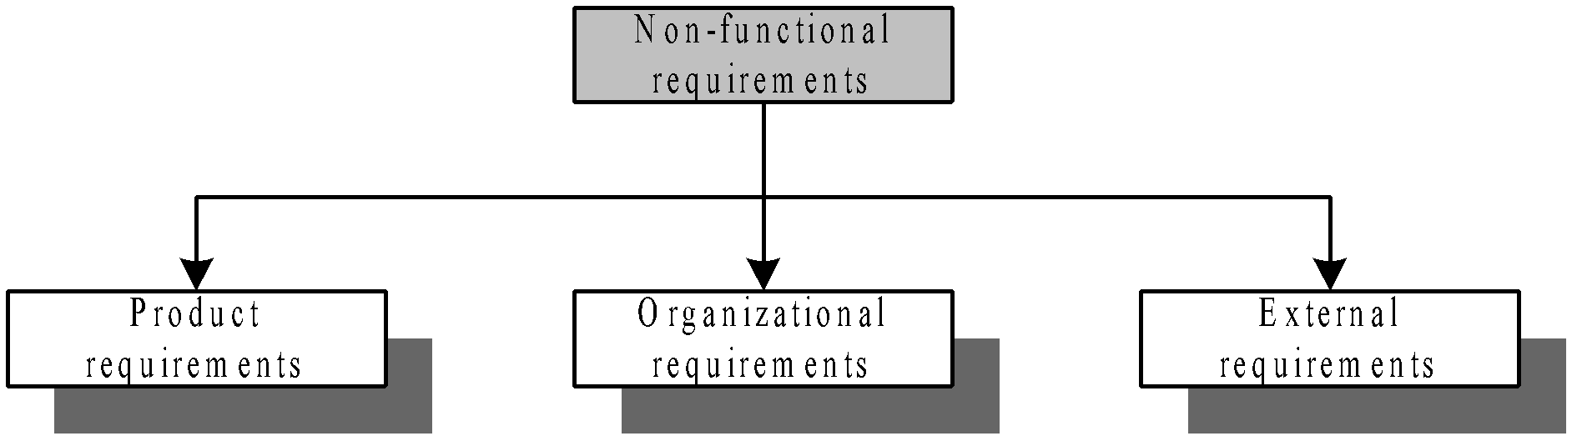
Non-Functional Requirements

Slide 16
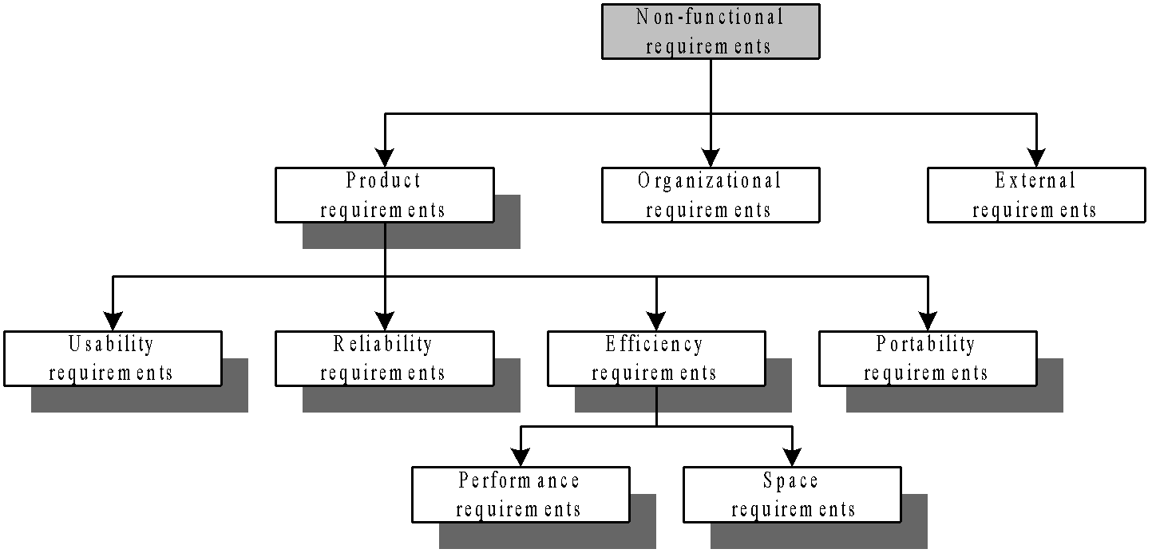
Non-Functional Requirements

Slide 17
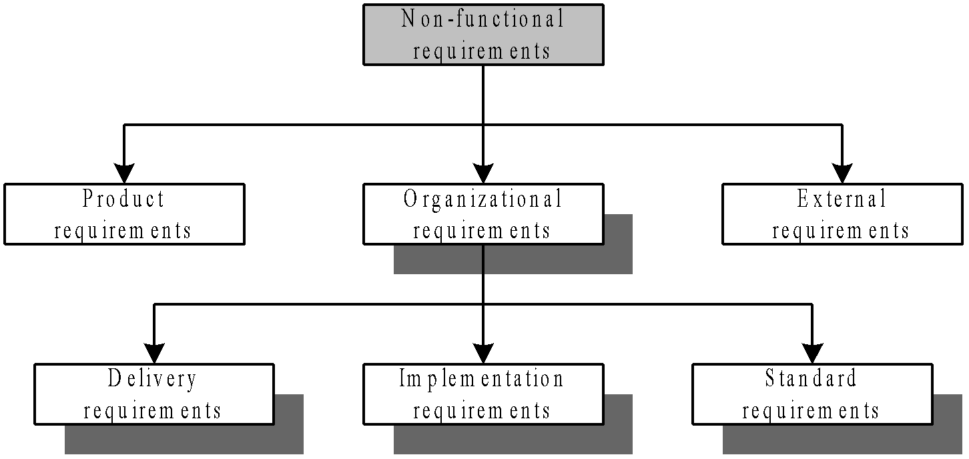
Non-Functional Requirements

Slide 18
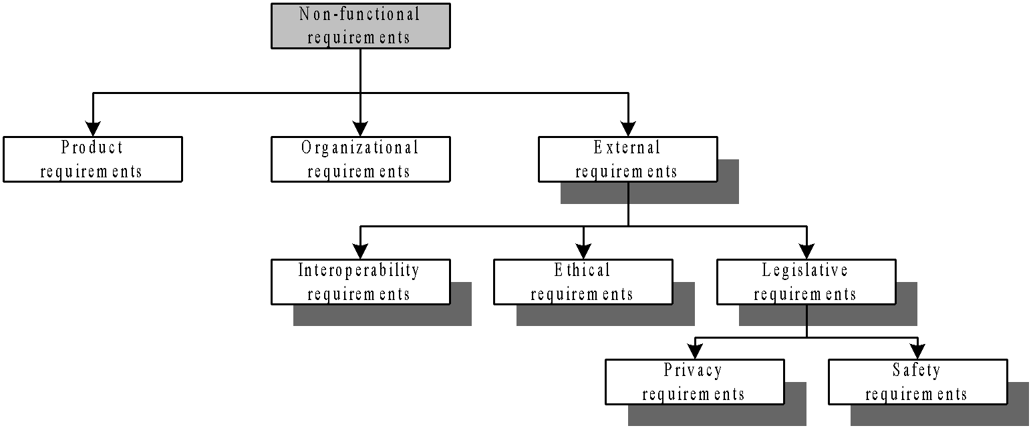
Non-Functional Requirements

Slide 19
Interface Requirements
Different interface for different functionality in the system
Specified with user’s level of understanding
GUI or Command based
With HCI perspective

Slide 20
SRS Document Template

Slide 21
Importance of SRS Document
Systematic organization of all the requirements
Cater to the needs of a wide variety of audience
Users, customers, marketing personnel
Software developers
Test engineers
User documentation writers
Project managers
Maintenance engineers

Slide 22
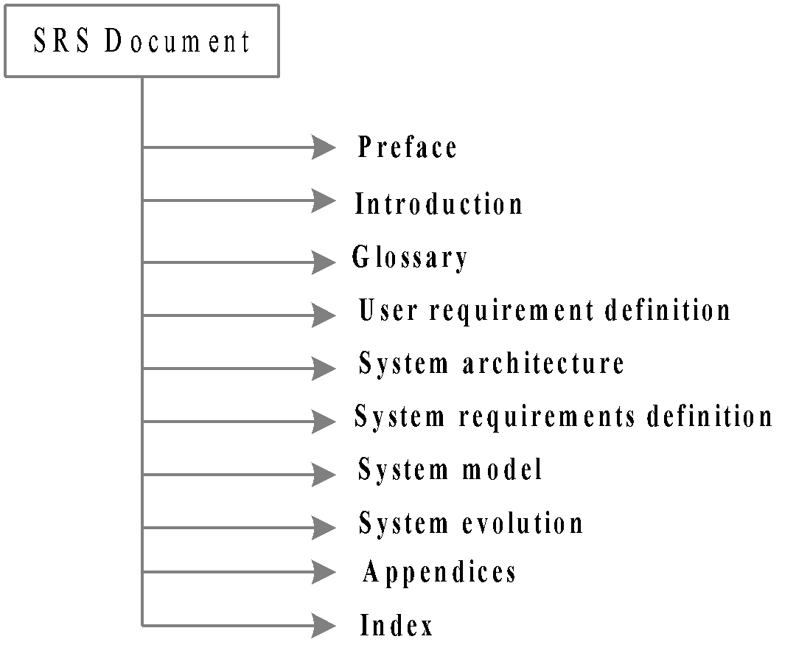
SRS Document Template

Slide 23
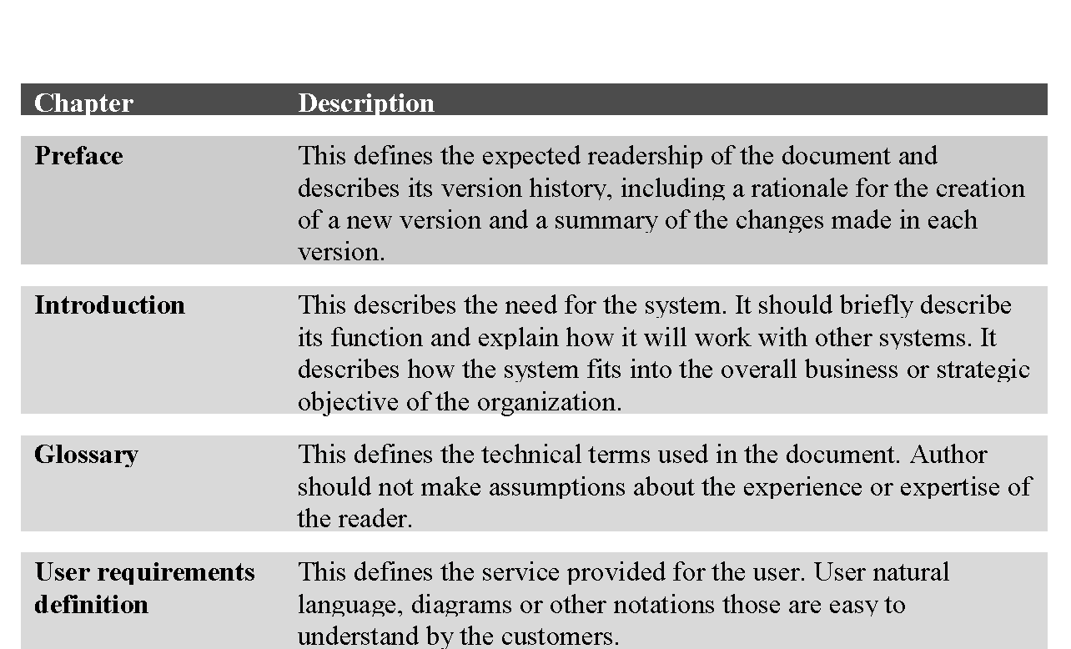
SRS Document Template

Slide 24
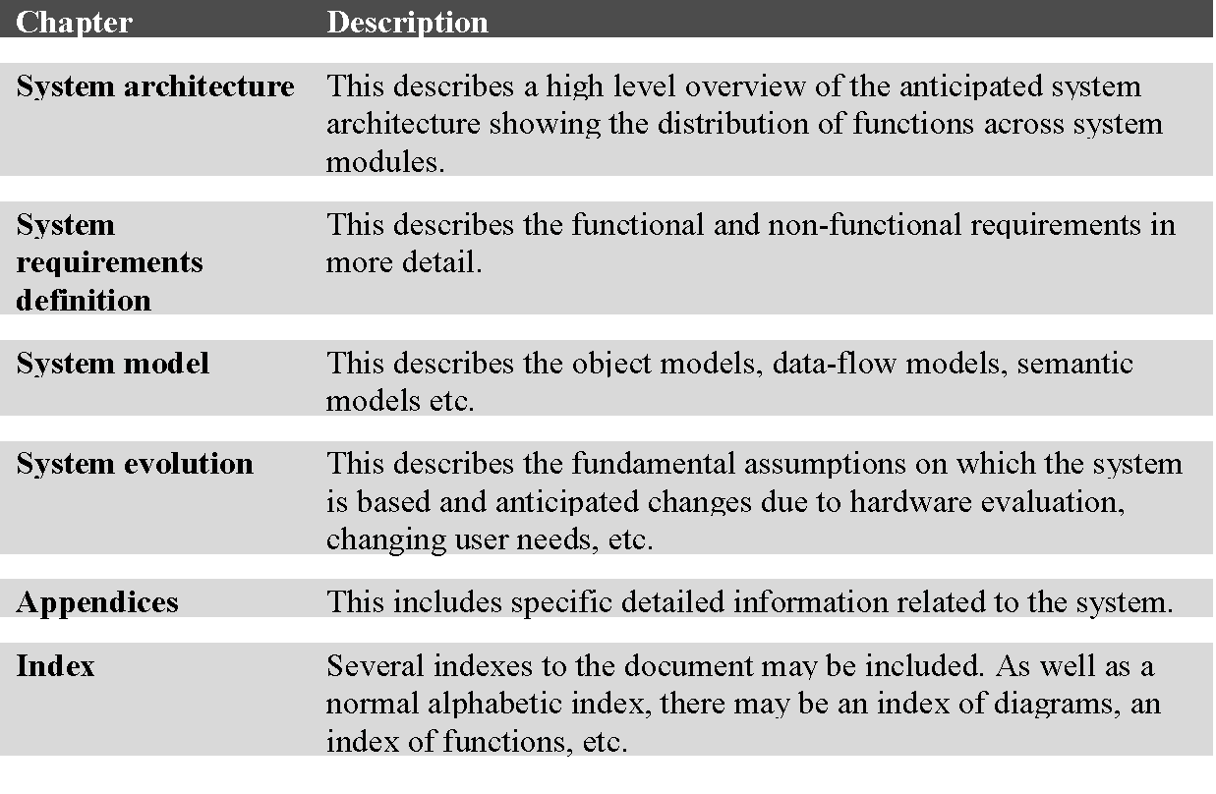
SRS Document Template (Cont’d)

Slide 25
IEEE Standard of SRS Document
For the IEEE Standard (1998) of SRS Document preparation, see the link below:
http://www.facweb.iitkgp.ernet.in/~dsamanta

Slide 26
Problems to Ponder
Why SRS document is often touted as a “Black Box” document?
“SRS document should be a flexible document” - Agree or disagree the comment
SRS can be taken as a legal document for the customer as well as the developer - Justify

Slide 27
Problems to Ponder
How Requirement Engineering is related to process development models?
How Requirement Engineering is related to software quality?
How RE takes place in Agile software development environment?

